Slide 1

ICIWorld.com
REAL ESTATE INFORMATION LISTING SERVICE

Slide 2
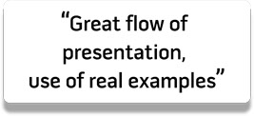
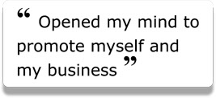

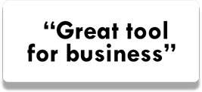


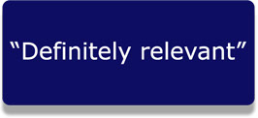
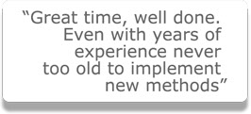

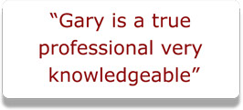
Welcome to
“How to Use the Powers of the Internet”
What attendees have said:
ICIWORLD.COM REAL ESTATE INFORMATION LISTING SERVICE since 1994

Slide 3

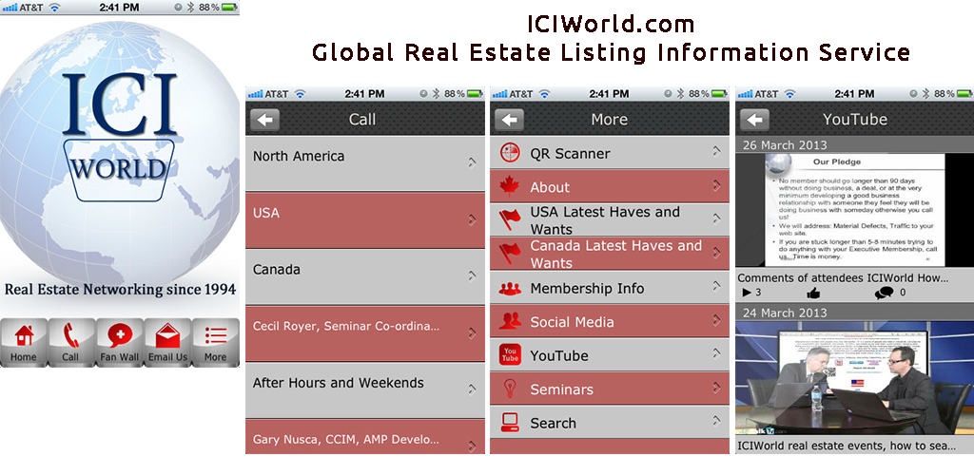



ICIWorld.com Mobile Apps
ICIWORLD.COM REAL ESTATE INFORMATION LISTING SERVICE since 1994

Slide 4

Franco Palermo, Salesperson, CAPITAL NORTH COMMERCIAL REALTY, BROKERAGE just informed me of two industrial buildings he sold this last year, one for $2,500,000 and one for $1,800,000 and that he just received an offer on another one.
Franco Palermo, Salesperson
Capital North Commercial Realty, Brokerage
ICIWORLD.COM REAL ESTATE INFORMATION LISTING SERVICE since 1994

Slide 5

An ICIWorld.com Executive Member should go longer than 90 days without doing business, a deal, or at the very minimum developing a good business relationship with someone they feel they will be doing business with someday otherwise you call us!
ICIWORLD.COM REAL ESTATE INFORMATION LISTING SERVICE since 1994

Slide 6
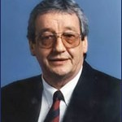

Commercial Division reports that he had resort with a golf course for sale on ICIWorld. He had it on for a month or so and had about six calls, one from a realtor in Ontario who had a buyer for a golf course. They worked a referral, and Ian sold the golf course portion and paid a referral fee to the broker on the sale of a $1,250,000 golf course. This also was great service to the public the buyer and the seller.
Ian has received many highly qualified buyers for specific types of property such as golf courses, and other recreational property, hotels, motels, and resorts.
MARKET REPORT 4/28/03: Ian reports the commercial market is very active and he has written over $5,000,000 this year already. One reason he is so active, is because Westjet is flying directly to Comox from Calgary and Edmonton, in only 1 hr. and 15 minutes. It is making a radical difference in the valley.
ICIWORLD.COM REAL ESTATE INFORMATION LISTING SERVICE since 1994

Slide 7
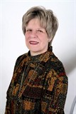

Jane Nichols, Sales Representative, Sutton Group Admiral Realty Inc., Brokerage. She advertised a residential property on ICIWorld and the mobile website that we supplied her. A buyer called Jane on a property. Jane met with her and developed a business relationship. Jane worked with her to find a suitable property and to help to sell a property. She downsized to a condo. And Jane has developed a new friendship with her.
ICIWORLD.COM REAL ESTATE INFORMATION LISTING SERVICE since 1994

Slide 8
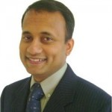

Shyamal Mahmood Sales Representative, Your Choice Realty Corp. Brokerage asked permission from another broker to advertise a Power of Sale on ICIWorld. It triggered a lead from a buyer who Shyamal developed a good business relationship with and he sold an investment property to him for $540,000+ and made $15,000. The buyer who is an investor is now using Shyamal to buy and sell real estate regularly.
Shyamal Mahmood, Sales Representative
Your Choice Realty Corp., Brokerage
ICIWORLD.COM REAL ESTATE INFORMATION LISTING SERVICE since 1994

Slide 9
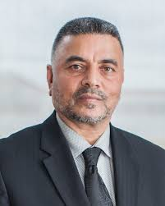

Video Recording from Realtor Quest Param Sidhu, CCIM, CEO-Broker of Record, Acres Real Estate Inc. – Commercial Real Estate Brokerage, has just informed me he has sold and leased several properties over the past year, such as leasing 24,000 sq. ft of industrial space, 1,000 sq. ft. offices, etc. He has sold 2,000 sq. ft of commercial retail condos.
Param Sidhu,CCIM, CEO-Broker of Record
Acres Real Estate Inc
https://www.youtube.com/watch?v=u4OBW8R04wc&feature=youtu.be
ICIWORLD.COM REAL ESTATE INFORMATION LISTING SERVICE since 1994

Slide 10

Amazing networking tool, protects clients confidential information, while marketing to masses.
Sold $3,000,000 industrial, my listing, via broker, 30+ showings.
Sold $7,500,000 land, my listing, direct buyer, 30+ calls.
Several other deals in the pipeline – land, industrial, commercial Essential tool for commercial brokers.
Narinder Bhachu B.Eng. CPPA, Sales Representative
Intercity Realty Inc, Brokerage
ICIWORLD.COM REAL ESTATE INFORMATION LISTING SERVICE since 1994

Slide 11

A Century 21 Sales Rep. placed a campground on the service and had it on for six months and received over 40 calls. One purchaser was not interested after seeing the property, but the sales person showed another property which he subsequently sold within one week of that buyer contacting him off ICIWorld. $17,000 commission.
He also had a farm advertised, received over 40 calls, he showed the farm about 10 times. One person who was not interested in this farm, the salesperson showed another farm that he subsequently sold. $20,000 commission.
ICIWORLD.COM REAL ESTATE INFORMATION LISTING SERVICE since 1994

Slide 12
A Century 21 Broker listed an office building exclusively for $1,650,000. Within 2-3 weeks of placing it on ICIWorld he received about 20 calls. He ended up selling it to a principal who had seen it on ICIWorld. Total commission was approximately $45,000. Some of these other buyers he is now working with.
He has had about six deals resulting from connections both directly and indirectly as a result of ICIWorld. He has sold a restaurant business, a triplex, he has leased half an office building over 6,500 sq. ft., for example and several more.
He says it is the easiest and most efficient method for both brokers and potential clients to find suitable investments for their clients. It certainly complements what is on his real estate board and fits together working side by side with his real estate board.
ICIWORLD.COM REAL ESTATE INFORMATION LISTING SERVICE since 1994

Slide 13
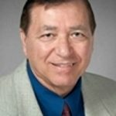
… reports selling an office building for $1,500,000. It was an exclusive listing not on a real estate board. He had more than 30 calls in a three week period. One was from one buyer and Michael sold it himself. And another happy satisfied customer on the road to creating wealth.
Michael Perretta, Broker of Record
CENTURY 21 Associates Inc., Brokerage
ICIWORLD.COM REAL ESTATE INFORMATION LISTING SERVICE since 1994

Slide 14
Steve Evans, Associate Broker, Century 21 “I just wanted to inform you that your system has enhanced my ability to secure Listings. When I show my clients that I have all these purchaser’s waiting to buy their property, they are quick to list their property or business with me. The fact that the Network has major players in the ICI Industry give the Network credibility. The bonus is to the public as they can also access the information. Glad to be aboard!”
ICIWORLD.COM REAL ESTATE INFORMATION LISTING SERVICE since 1994

Slide 15
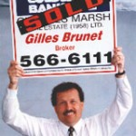

Recently Retired 2 Decades with ICIWorld
Recently Retired. Really enjoyed the ICI WORLD over 2 decades and made nothing but good clients from it. Lots of commercial $$$$$. You have the best commercial web program out there, I loved it.
Thx for all you’ve done for me over the many years! Gilles Brunet
Gilles Brunet, Retired
ICIWORLD.COM REAL ESTATE INFORMATION LISTING SERVICE since 1994

Slide 16
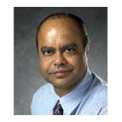

Sold a 26 unit apartment building for $2,350,000.
He placed it on ICIWorld and received about 10 calls in the first week from ICIWorld and 6 calls from his real estate board. One call was from a principal show saw it on ICIWorld and bought it. He says he has tried many other services but this is the best. See Al’s web site and how ICIWorld links work to provide opportunities for Al to serve the public.
He also sold another a 16 suite apartment listed on the service by another member. Good work. Well done.
Al Dharsee, Sales Representative
ICIWORLD.COM REAL ESTATE INFORMATION LISTING SERVICE since 1994

Slide 17
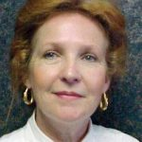

Maryjane White, Sales Representative, Royal LePage Triland Brokerage, London, Ontario sold a mobile home park $1.3M and gets leads on and has sold many homes parks as her specialty.
Maryjane White, Sales Representative
Royal LePage Triland Brokerage, London, Ontario
ICIWORLD.COM REAL ESTATE INFORMATION LISTING SERVICE since 1994

Slide 18
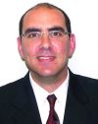
Hi Gary,
I would like to thank you for all your help and support. I recently sold (conditionally) an Apt building around the $13,000,000 and I located the buyer through ICI World.Although I advertised in the Globe & Mail and in the the Commercial Investor in addition to listing the property on the MLS, most of my solid leads came from ICI World.I contacted professionals via ICI World and they responded immediately. Thanks again for your support and I would like to book a webiner next week to better understand how to fully utilize ICI’s website.Also, you mentioned that CCIM will have designation courses in Toronto, can you please send me information in that regards,
Best wishes,
Guy Scheiner, BA
Sales Representative
Sutton Group-Admiral Realty Inc., Brokerage
ICIWORLD.COM REAL ESTATE INFORMATION LISTING SERVICE since 1994

Slide 19


Sam Schariefy, Abr., Sres., Re/Max Realtron Realty Inc., Brokerage. Someone saw an ad on ICIWorld on one of Sams exclusive listings. Sam developed a business relationship with them and said that property was not the right property for you. We have other listings and told him about another one. He also invited him to come into office and had a two hour meeting. Sam suggested a property. Sam knew about a person who was thinking about selling. He called him and ended up doing a deal $1,100,000. $30,000 commission and a job well done for both parties. They were both very happy.
Sam also has buyers from overseas looking to buy a business and home, and more buyers and sellers.
Sam Schariefy, Abr., Sres.,
Re/Max Realtron Realty Inc., Brokerage
ICIWORLD.COM REAL ESTATE INFORMATION LISTING SERVICE since 1994

Slide 20
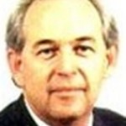
$12,500 Referral Commission, took 2 min. and 30 seconds
An apartment building $12,500 commission, he was chatting with another real estate agent in his office who wanted an apartment in Windsor. Brian went to ICIWorld pulled off an apartment and gave her the info as a referral. He did not hear anything for 3 months and then got a cheque for 12,500 for doing a referral. It took 2 min. and 30 seconds. That was it!
Another deal he leased some office space in Brampton to a major company on the stock exchange. 3,000sf He had it listed, He got a call direct from prospective tenant. Showed the property and did the deal on the same day. 5 year lease $10,000.
Another was piece of vacant land in Muskoka. He listed it on ICIWorld and it sat for six months, got a call from an agent in Muskoka who arranged to see it and deal was done. Brian never did go to Muskoka. He showed it and sold it, $3,500 commission. He never did go to Muskoka.The apartment and office lease were on MLS and advertised and sold and leased through ICIWorld. Land was exclusive on ICIWorld.
ICIWORLD.COM REAL ESTATE INFORMATION LISTING SERVICE since 1994

Slide 21
Scott Anderson, Broker, Re/Max Real Estate Centre, Brokerage placed a medical building on ICIWorld last year. It generated leads. He developed a business relationship with one of the buyers and during the following year sold five medical buildings to him for approximately $10,000,000. All started with one simple “Have” message on ICIWorld. Scott not only deals in medical buildings but also self storage and industrial buildings, and more.
Scott Anderson, Broker
Re/Max Real Estate Centre, Brokerage
ICIWORLD.COM REAL ESTATE INFORMATION LISTING SERVICE since 1994

Slide 22
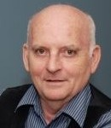
….reports several deals such as 5 plexes and other residential income producing properties.
Erwin Stone, Broker
Royal LePage Heartland Realty
ICIWORLD.COM REAL ESTATE INFORMATION LISTING SERVICE since 1994

Slide 23
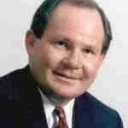
Reports selling a $4,200,000 apartment building and an $800,000 office building. The buyer from Europe saw it on the Internet on ICIWorld and from all the information and the pictures made an offer subject to inspection. He flew over to see it, did his due diligence and bought it. Of course there is a lot of work, correspondence and developing of a good long term business relationship that made it all happen. The ICIWorld connection played a small but vital role in making the connection to benefit everyone.
Bruce Cooke, BBA, CCIM, SIOR, Commercial Sales Representative
Royal LePage ProAlliance Realty, Brokerage
ICIWORLD.COM REAL ESTATE INFORMATION LISTING SERVICE since 1994

Slide 24
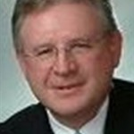
Hugh Nichols, Broker, Re/Max North Country Realty Inc. Brokerage has sold two buildings and leased out some retail space. One was a main street building commercial with two apartments as an investment $339,000 and the other was a commercial building with nine residential units and two commercial units also in Gravenhurst. They were both placed on ICIWorld. Hugh received about four calls and two of them purchased. The leased unit 3,200 sq. ft. was for a restaurant and he received one call and they leased it for five years. Whenever Hugh receives calls they tend to be well qualified as prospects. The Muskoka area that Hugh works is a tourist and a growing senior community. Feel free to contact him anytime.
ICIWORLD.COM REAL ESTATE INFORMATION LISTING SERVICE since 1994

Slide 25
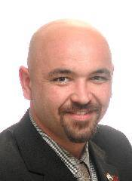
Ted Davis, Sales Representative, Re/Max Eastern Ontario Inc. Ted has done one million deals AND fifteen referrals! Within 30 days of joining ICIWorld he advertised a commercial property. He received calls and although one particular person was not interested in the property he had advertised, Ted showed him another one which was on MLS and he sold it.
ICIWORLD.COM REAL ESTATE INFORMATION LISTING SERVICE since 1994

Slide 26

ICIWORLD.COM REAL ESTATE INFORMATION LISTING SERVICE since 1994

Slide 27

ICIWORLD.COM REAL ESTATE INFORMATION LISTING SERVICE since 1994

Slide 28

ICIWORLD.COM REAL ESTATE INFORMATION LISTING SERVICE since 1994

Slide 29
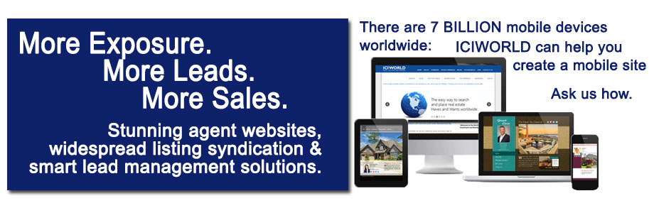
ICIWORLD.COM REAL ESTATE INFORMATION LISTING SERVICE since 1994

