Slide 1
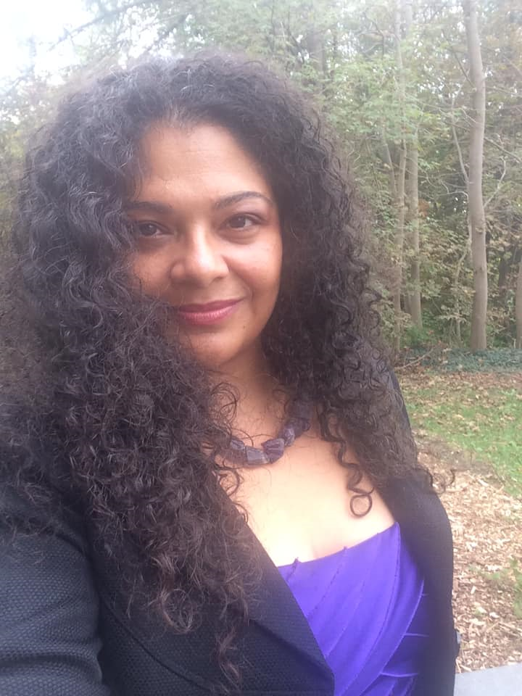
Welcome to
Sabrina Di Marco, MBA, Broker
Realtor since 1995
Business Consulting, Former Adjunct Professor at Humber College Business School
Speaker for ICIWorld at Real Estate Boards & Offices
Founder & President of Making Multiculturalism Work Inc.
Mastering the Powers of the Internet
Notes:
Introduce yourself, talk about something positive, new housing starts are up, Blue Jays won, great weather
Hello! My name is Gary Nusca and I have been working in real estate for 46 plus years. It is really nice to be able to present office seminars in person again.
The internet plays a big role in our business lives. It brings with it great potential, but also some significant challenges. Today I would like to have a look at some of those challenges but also present solutions to help you.

Slide 2
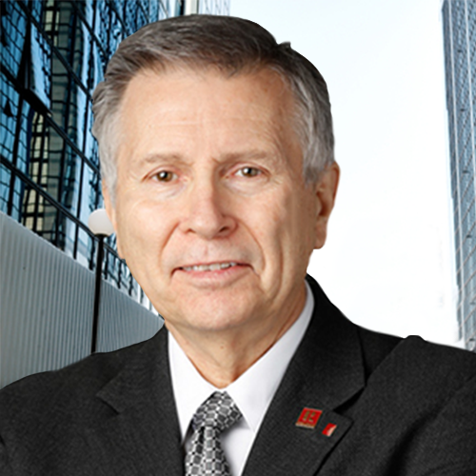
Welcome to
Gary Nusca CCIM CIPS, Realtor, Broker for 49 Years
Business Coach & Mentor
Speaker at Real Estate Boards & Offices
Founder & President of The Market ICIWorld.net INC
Mastering the Powers of the Internet
Notes:
Introduce yourself, talk about something positive, new housing starts are up, Blue Jays won, great weather
Hello! My name is Gary Nusca and I have been working in real estate for 46 plus years. It is really nice to be able to present office seminars in person again.
The internet plays a big role in our business lives. It brings with it great potential, but also some significant challenges. Today I would like to have a look at some of those challenges but also present solutions to help you.

Slide 3

Mastering the
Powers of the Internet
How to Work Exclusive Real Estate Information
Networking and Lead Generation
Presented by Sabrina Di Marco, MBA, Broker, Multicultural Trainer
ICIWorld.com (Since 1994)
Association of Real Estate Brokers & Salespeople
WE ARE ASSISTANTS TO REAL ESTATE BROKERS AND SALESPEOPLE WORLDWIDE

Slide 4

What you will learn from this seminar
How to do business everyday.
Leader in technology solutions for professional realtors
How to improve your network.
How to generate leads from your website.
How to do more deals.
Impress your clients with your access to buyers.
Daily listings and exclusives give prospects a reason to return to your website.
How to add instant inventory to your website all in a way that YOU get the calls.
Notes:
In a few minutes I am going to introduce you to Real Estate IDX that will help you capitalize on your marketing, do referrals, network, connect and close more deals.
These are a few of our day to day problems as professionals realtors. I know these issues, I used to experience them myself. I talk to real estate professionals, just like you everyday. You may not be coming up against all these problems, you may only struggle with a couple. If any are causing you to not earn money, well, that is a problem.

Slide 5

Agenda
What is ICIWorld and How Does it Work?
How to Work Exclusive Listings in compliance with RECO?
How to Make it Work for You?

Slide 6
What is ICI World and How Does it Work?

Slide 7
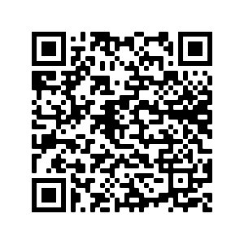
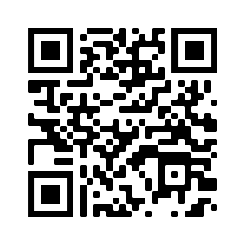
Android
Install the APP
iOS
Notes:
Open Camera app, aim at the QR code and let camera scan, click and follow the link

Slide 8


Real Estate App - Free
Search 30,000+ Haves & Wants
3-7 Seconds to See the Latest Listings
Android: Play Store… Search ICIWorld - Install
iPhone: App Store… Search ICIWorld - Install
ADD MOBILE VERSION SHORTCUT www.ICIWorld.com
Commercial AND Residential
Notes:
More mobile devices than humans!

Slide 9
Search HAVES AND WANTS
Commercial, Ontario, Apartment Buildings, Haves, Sort by Price
Business Opportunities, GTA, Keyword Restaurants, Want, Have/Want Age to Any Age
Commercial, Ontario, Subdivision Potential Condo Sites, Haves, Sort by Price
Residential, GTA, Keyword Assignments, Any Age

Slide 10
Add/Modify/Delete
Listings, Haves and Wants
Listings, Haves and Wants
Recommendations
Go to iciworld.com
Click on Member Login
Log In Member Management Page
All choices are on the left
Add Listings, Haves/Wants
My Listings to modify, delete
Click Latest World to Check
Reach the world with one click
Maintain a minimum of fifteen Haves and Wants
Modify listings every 30-60 days with two clicks
Never let listings go longer than 90 days old. They are not displayed on mobile Apps for Androids, iPhones.
Read once the Log In Member Management Page or you can miss doing deals.

Slide 11
Executive Member
Training and Support
By Appointment
One on One
Go to iciworld.com or the mobile App or iciworld.mobi
Click on make an appointment
10 minutes before your time go to iciworld.com click on Webinars Workshop
Ensures Our Pledge works for everyone
Measure results every 90 days.
Orientation printout online
Log In Member Management Page
Miss one item and you can miss doing deals
ICIWorld Educational YouTube Channel
https://www.youtube.com/user/iciworldinc/videos

Slide 12
Search ICIWorld.com
Commercial and Residential
30,000+ Haves and Wants
75% EXCLUSIVE listings NOT on MLS
Commercial + Residential
FSBOs*
Assignments*
… and more!
*Postings

Slide 13
How to Work ICI World’s Exclusive Listings?

Slide 14
How to work real estate Have and Want exclusive information that generate leads just like real estate board listings do.
This provides extra opportunities for you to make money that you do not have now.

Slide 15

Business @ the Speed of Thought
Link
Notes:
Business @ the Speed of Thought^{[1]} is a book written by Bill Gates and Collins Hemingway in 1999. It discusses how business and technology are integrated, and shows how digital infrastructures and information networks can help someone get an edge on the competition.
Gates asserts cyberspace and industry can no longer be separate entities, and that businesses must change to succeed in the Information Age. Though the book is not a technology handbook it gives interesting insights as to how to integrate business process with technology. It gives one an understanding of how advances in networking and information technology can make a difference in day-to-day business.

Slide 16
First words of Bill Gates to Warren Buffet about the Internet
“the cost to publish your information, getting your message in front of someone, talking with people around the world is zero or so close to zero it doesn't make any difference.”
ICIWorld is a World Information Listing Service
Must manage information in the right way.
Survey of inventory in the room.

Slide 17
Opportunities to Build Your Inventory on the Internet – 7 billion people!
FSBOs
Open listings
Exclusive (non-MLS) listings
Builders
Expired
Want to sell quietly
ICIWorld has the platform proven over 20 years
Notes:
What can you add to the list?

Slide 18
Has anyone ever said to you “I want to sell my property but I do not want to give you a listing at this time.”
“If you bring me a buyer, I will pay you a commission.”

Slide 19
How to do business in your daily business travels.
Ask to speak to the business owner of any and all businesses you visit.
If not there, leave a business card.
They will come over and say “may I help you?”
Introduce yourself with your business card.

Slide 20

“May I ask you a business question?”

Slide 21
Then ask them “if I was to get you the price you wanted, would you consider selling?”
If they say “no” not at this time, you have just planted a seed for the future.
If they say “yes” bring me in a buyer for $1.2M, I will sell it today, but I do not want to sign a listing.”
They all say that, right or wrong?
Notes:
If they say “no.” They will keep your business card and call you back someday. You have planted a seed for future business.
If they say “yes, bring me in $1.2M for my business, and I will sell it today, but I do not want to give you a listing, but I will pay you a commission.”
At this point, you must ask the three special questions we have been teaching for 20 years.

Slide 22

Do you know the 3 questions?
Notes:
Can you ask to speak to the owner of any business that you visit? Of course.
Introduce yourself. I am in real estate. Give them your business card so they know you are for real.
Mention that you work in the area and would like to introduce yourself.

Slide 23

Can you master 3 simple questions
Will you pay me a commission if I bring a buyer? Then negotiate the commission.
Will you give me a 48 hr. exclusive listing to show the property once I have a buyer?
May I advertise your property. I am going to do it without disclosing the address.

Slide 24
RECO
…A registrant shall not include anything in an advertisement that could reasonably be used to identify specific real estate unless the owner of the real estate has consented in writing.

Slide 25
If you do not have a signed listing people can go behind your back.

Slide 26
Advertise Information
"Mississauga Restaurant $350K, Making money“
“Toronto Triplex, $750,000 Positive cash flow, great tenants."
“Oakville 4 BR 2 Storey, $1M, under market, not on MLS”
Most owners will give you permission to advertise in this way… as long as the address/location of the property cannot be gleaned from the ad.

Slide 27
More Examples
Lindsay Esso Gas Station
Brantford $30M shopping centre
Peterborough Retail Plaza $500K

Slide 28
When someone calls you
When someone calls you they will ask for the address.
You make a statement “in this particular case we have to put an agreement in place first, but if it is okay with you I can show it to you on Sat, come to my office and I will make arrangements for you to see it.”
On Fri. you go get a 48 hr exclusive listing agreement to show it.

Slide 29
How We Help You
Widgets… active links that go on your existing website
Display listing data… multiple and exclusive… and property information… on your site… drive leads directly to YOU
Demo

Slide 30
3
Real estate widgets that you can add to YOUR website of listings and exclusive information that make it absolutely inevitable for you to generate leads from YOUR website.
One lead can make one a lot of money.

Slide 31
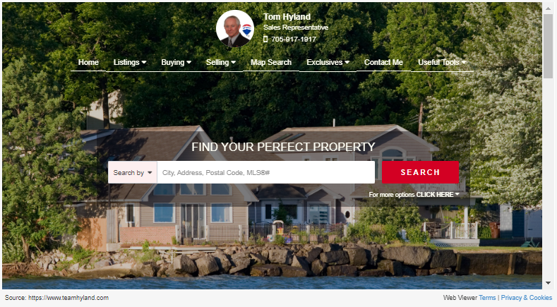
Member Web site LIVE
Notes:
Must use your mouse on the big display screen to navigate
This is a members site. Live on the internet. That ‘Exclusives’ button has been Tom’s golden ticket for over 10 years. It gives him access to another dimension in real estate information that he can network and market himself with, make new connections, do referrals, show his real estate activity and close more deals.
When visitors come to his site and see real estate information in the EXCLUSIVE menu selection they have only Tom to call. No one else. He controls the information.

Slide 32
How to Make it Work for You?
Sign up with ICIWorld Today!

Slide 33


Know Our Pledge
● As a member of ICIWorld, if you go more than 90 days without doing business, or at the very least, without developing a new business relationship with someone you feel will lead to doing business, by using the tools we supply to you, call us… and let us train you how to do it!

Slide 34


Slide 35


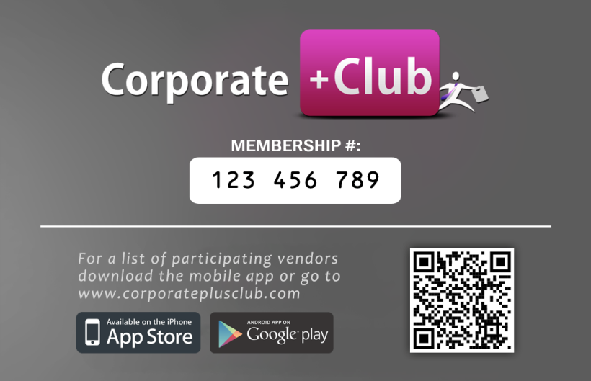
Discount Program
$100’s Discounts
Referral Program

Slide 36
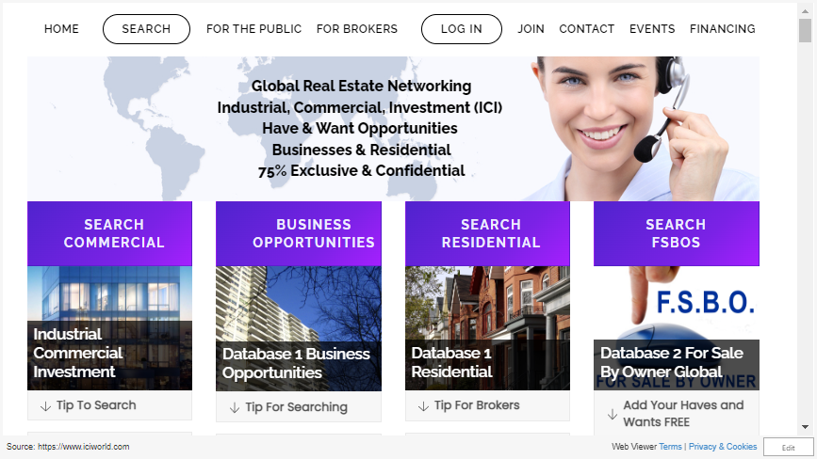

Slide 37

Survey – Feedback 1 minute
We appreciate your feedback
Helps us to improve our existing tools and develop more programs that will benefit you.

Slide 38
Can I do it On Line Now?
Special Seminar Offer $240 or $30/mo:
Save $79 - 25% OFF (Regular $319)
Go to www.iciworld.com,
Click on Join
Join with Referral and Specials
Make An Appointment
(at the top at iciworld.com, on mobile click login)

